Slide 1
Introduction to Computer Science and Programming
Labo 15 – Hands-On Practice Lab
Laboratory 15, March 26, 2026
Filippo Ricca - Muhammad Mohsin
DIBRIS, University of Genova

Slide 2

Today…
Today's lab is dedicated to hands on practice for understanding of fundamental aspects of the discipline and to verify the students’ understanding in coding.
This lab will help to prepare for next evaluated lab.
• Covered topics in the today evaluated lab:
Theoretical aspects explained during the lessons
Exercise and practical aspects:
Functions and Arrays
Strings
Structures
Pointers

Slide 3
Hands on Practice Lab – Instructions and Rules
Given the following C++ programs, explain what happens if you try to compile them with a C++ compiler (for example, the one used in class) and execute them providing the inputs that will be given next to the "INPUT:" tag.
Next to the "OUTPUT:" tag, write the expected result after compilation and execution (clearly indicating if the program compiles). So, next to OUTPUT one might write: Compile time error or the result of the execution (which could also be a runtime error, such as dividing a number by zero).

Slide 4
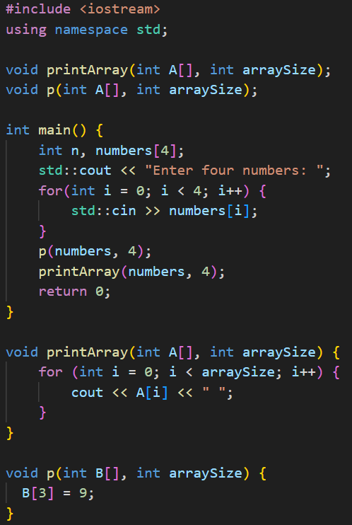
Exercise 1:
INPUT: 1 2 4 5
OUTPUT:

Slide 5
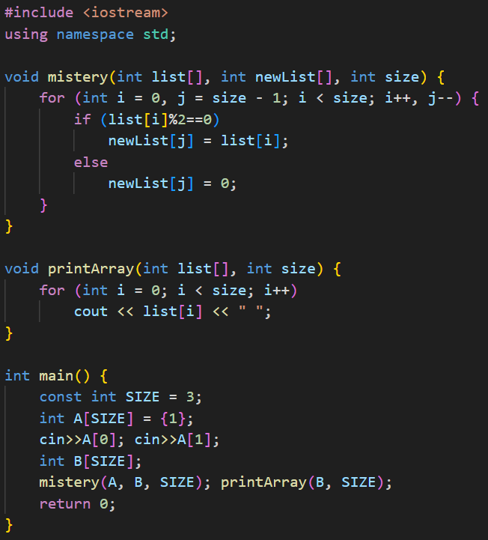
Exercise 2:
INPUT: 5 8
OUTPUT:

Slide 6
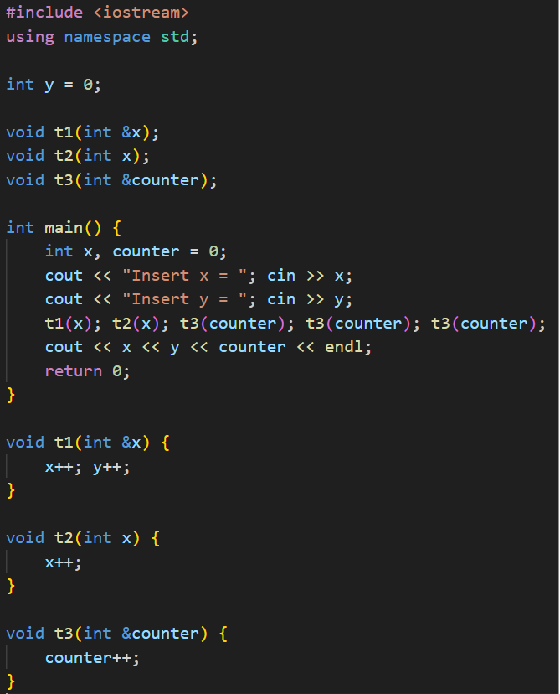
Exercise 3:
INPUT: 4 6
OUTPUT:

Slide 7
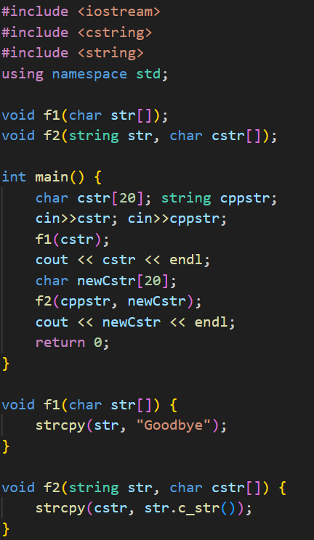
Exercise 4:
INPUT: John Doe
OUTPUT:

Slide 8
Instructions and Rules – Pay attention
Given the following C++ programs, explain what happens if you try to compile them with a C++ compiler (for example, the one used in class) and execute them providing the inputs that will be given next to the "INPUT:" tag.
Next to the "OUTPUT:" tag, write the expected result after compilation and execution (clearly indicating if the program compiles). So, next to OUTPUT one might write: Compile time error or the result of the execution (which could also be a runtime error, such as dividing a number by zero).

Slide 9
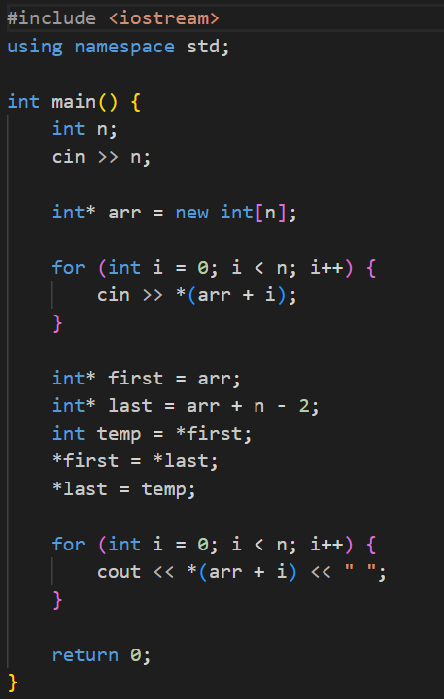
Exercise 5
INPUT: 5 5 4 3 2 1
OUTPUT:

Slide 10
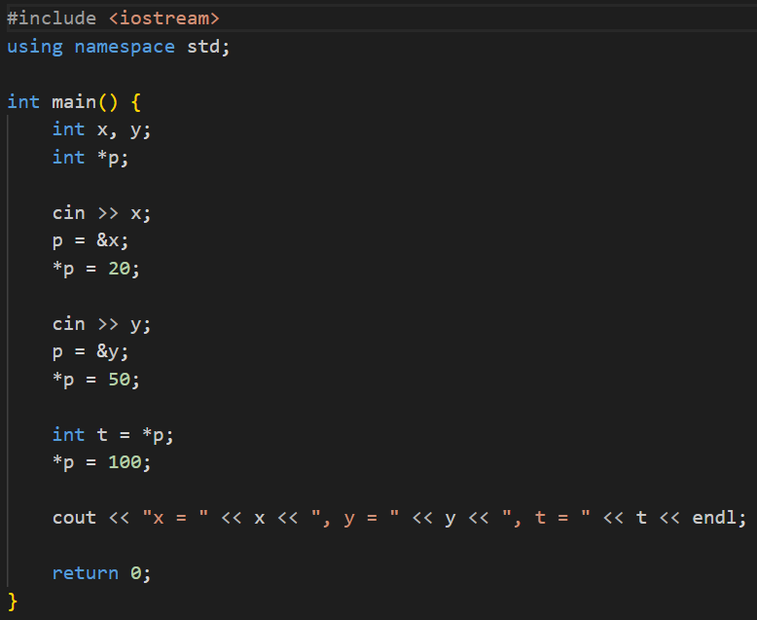
Exercise 6
INPUT: 3 8
OUTPUT:

